Slide 1
Classes of IP addresses
NAME – Subham pritansu sahu
REGD NO – 210301121286
SUB – computer installation and maintance

Slide 2
TCP/ip defines five classes of IP addresses:-
Class A,B,C,D and E . Each class has a range of valid IP addresses.
The value of first octect determines the class.
Ip addresses from the first three classes (A,b,and c)can be used for host addresses.
The other two classes are used for other purpose(class D for multicast and class E for
Experimenta purposes).

Slide 3
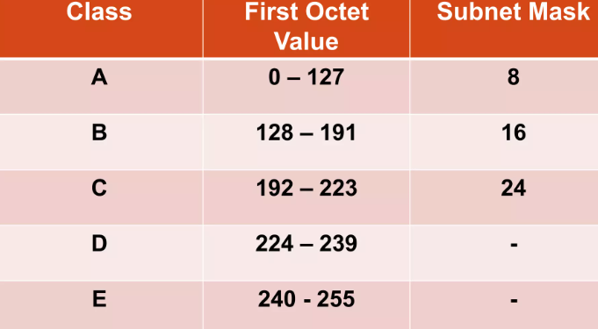
Classes of IP addresses :-

Slide 4
Special IP addresses ranges :-
0.0.0/8 addresses used to communicate with the current network
127.0.0.0/8 – loopback addresses
169.254.0.0/16- link-local addresses

Slide 5
Thank you

